Slide 1
Deep Learning in Image analysis Lecture 3
Takashi Sato & Tom Jhou

Slide 2
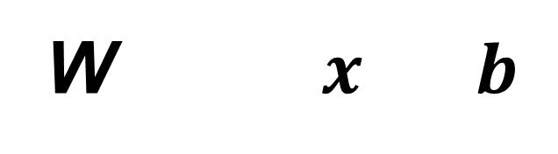
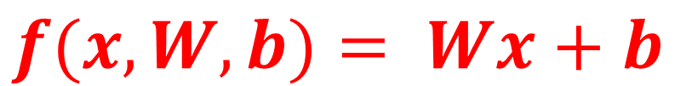
Linear classifier
$$f(x,W, b)= Wx+b$$
Weights
(10 x 3072)
Image
(3072,1)
Biases
(10,1)
Scores
(10 x 1)
25
w_{1,1}
w_{1,2}
...
w_{1,3071}
w_{1,3072}
29
b₁
25 x w_{1,1} + …. + 72 x w_{1,3072}
+b₁
cat
w_{2,1}
w_{2,2}
...
w_{2,3071}
w_{2,3072}
b₂
25 x w_{2,1} + …. + 72 x w_{2, 3072}
+b₂
W$x b$
=
dog
+
........
......
......
......
......
w_{10,1}
w_{10,2}
...
w_{10,3071}
w_{10,3072}
119
b₁₀
+b₁₀
25 x w_{10,1} + …. + 72 x w_{10,3072}
car
72
Input
Output
w_{1,1}
25
w_{1,2}
29
11.95
w_{1,3}
12.13
......
119
...
...
......
w_{1,3072}
72
2.56
(3072)
(10)

Slide 3
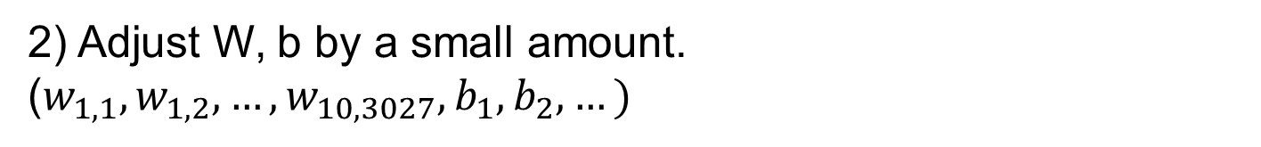
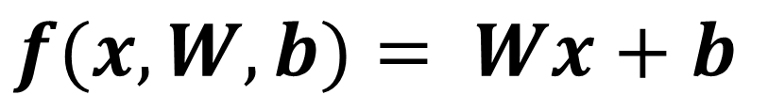
Linear classifier
$$f(x,W, b)= Wx+b$$
Using 50k training dataset, optimize W, b iteratively.
The training starts with a random values in W, b.
1) Evaluate the linear classifier.
2) Adjust W, b by a small amount.
($w_{1,1},w_{1,2}, …,w_{10,3027},b_{1},b_{2}, …)$
Notes:
these templates later, but for now let’s assume that the program has created templates, and let me explain how the program use these templates.

Slide 4
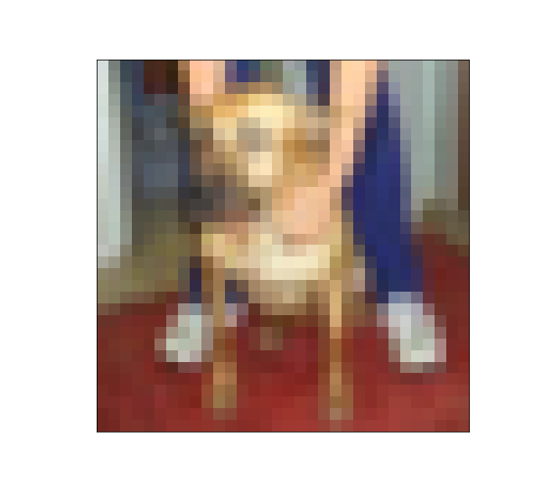
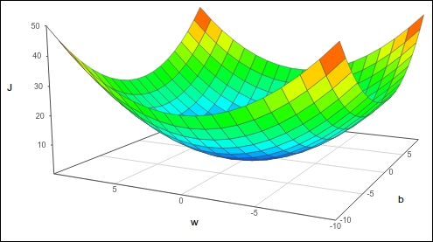
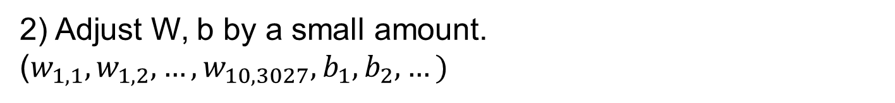

Linear classifier
1) Evaluate the linear classifier.
Scores
Image $x^{(i)}$
cat:
3.8
3.6
3.8
3.2
dog:
-1.1
2.6
3.9
5.1
car:
1.3
2.3
2.0
-1.7
W (1)
W (2)
W (3)
W (4)
loss function: How bad are the predictions?
2) Adjust W, b by a small amount.
($w_{1,1},w_{1,2}, …,w_{10,3027},b_{1},b_{2}, …)$
Minimize loss function with respect to W and b

Slide 5

Loss function (max vs. softmax)
Image $x^{(i)}$
Which one
is the max?
Correct
answer
Scores
cat:
3.2
0
0
dog:
5.1
1
=
1
Correct (0)
car:
-1.7
0
0
cat:
3.6
1
0
dog:
2.6
0
≠
1
Wrong (1)
car:
2.3
0
0
cat:
3.8
1
0
dog:
-1.1
0
≠
1
Wrong (1)
car:
1.3
0
0

Slide 6
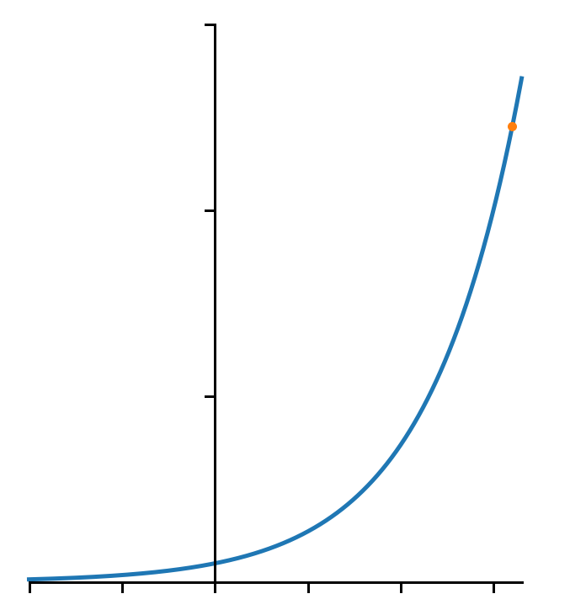



Loss function (max vs. softmax)
Image $x^{(i)}$
Convert
to > 0
Normalize
(sum = 1)
Correct
answer
Scores
cat:
3.2
24.5
0.13
0
exp
normalize
dog:
5.1
164.0
0.87
1
car:
-1.7
0.18
0.00
0
$$\frac{24.5}{24.5+164.0+0.18}$$
$$e^{3.2}=24.5$$
30
20
$$e^{x}$$
10
-2
-1
0
1
2
3

Slide 7
Loss function (max vs. softmax)
Image $x^{(i)}$
Convert
to > 0
Normalize
(sum = 1)
Correct
answer
Scores
cat:
3.2
24.5
0.13
0
exp
normalize
dog:
5.1
164.0
0.87
1
car:
-1.7
0.18
0.00
0
cat:
3.6
36.6
0.61
0
exp
normalize
dog:
2.6
13.5
0.22
1
car:
2.3
9.97
0
0.17
cat:
3.8
44.7
0.92
0
exp
normalize
dog:
-1.1
0.33
0.007
1
car:
1.3
3.67
0.08
0

Slide 8
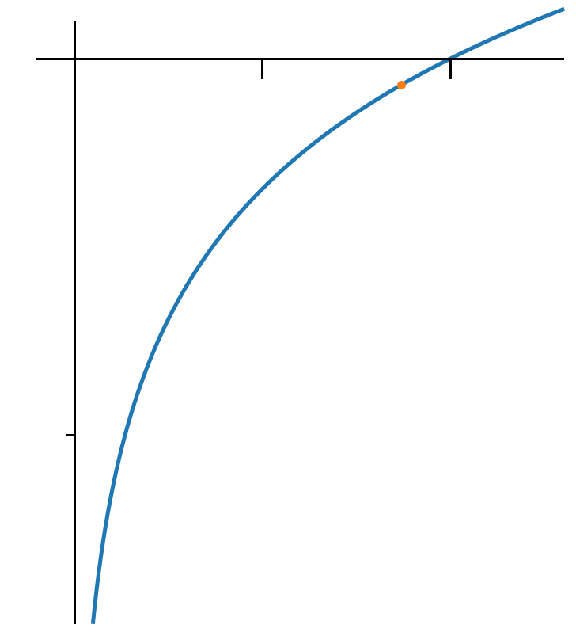

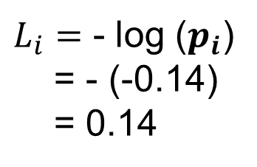


Loss function (max vs. softmax)
Image $x^{(i)}$
Convert
to > 0
Normalize
(sum = 1)
Correct
answer
Scores
cat:
3.2
24.5
0.13
0
exp
normalize
dog:
5.1
164.0
0.87
1
car:
-1.7
0.18
0.00
0
Quantify how far this is
From the answer
0
1
$$p_{i}=0.87$$
$$\log{x}$$
$$\log{p_{i}}=−0.14$$
$L_{i}=$ - log ($p_{i}$)
= - (-0.14)
= 0.14
-2

Slide 9
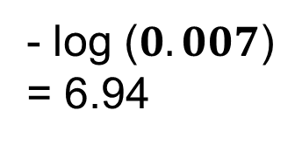
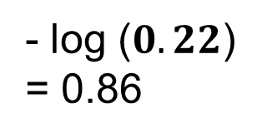
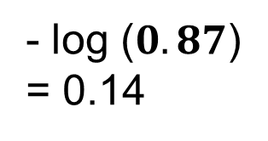
Loss function (max vs. softmax)
Image $x^{(i)}$
Convert
to > 0
Normalize
(sum = 1)
Scores
Target
cat:
3.2
24.5
0.13
0
exp
normalize
dog:
5.1
164.0
0.87
1
car:
-1.7
0.18
0.00
- log ($0.87$)
= 0.14
0
cat:
3.6
36.6
0.61
0
exp
normalize
dog:
2.6
13.5
0.22
1
car:
2.3
9.97
- log ($0.22$)
= 0.86
0
0.17
cat:
3.8
44.7
0.92
0
exp
normalize
dog:
-1.1
0.33
0.007
1
car:
1.3
3.67
- log ($0.007$)
= 6.94
0
0.08

Slide 10
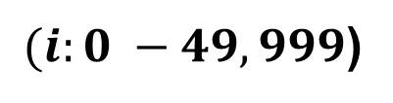
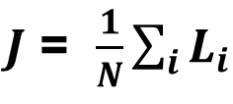
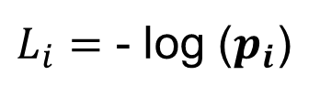

Loss function (max vs. softmax)
Image $x^{(i)}$
Convert
to > 0
Normalize
(sum = 1)
Scores
Target
cat:
3.2
24.5
0.13
0
exp
normalize
dog:
5.1
164.0
0.87
1
car:
-1.7
0.18
0.00
0
Distance
from the target
$J$ = $\frac{1}{N}\sum_{i}{L_{i}}$
$(i:0 −49,999$)
$L_{i}=$ - log ($p_{i}$)
What is the min/max possible loss $L_{i}$?
Min 0, max: Inf
If all scores are similar, what is the loss (3 categories)
- log (1/3) = 1.09
If all scores are similar, what is the loss (10 categories)
- log (1/10) = 2.30

Slide 11
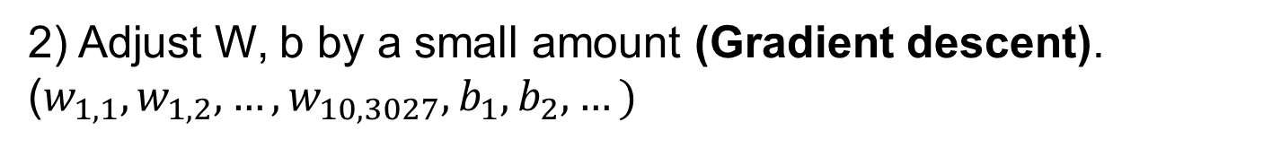
Linear classifier
$$f(x,W, b)= Wx+b$$
Using 50k training dataset, optimize W, b iteratively.
The training starts with a random values in W, b.
1) Evaluate the linear classifier (loss function).
2) Adjust W, b by a small amount (Gradient descent).
($w_{1,1},w_{1,2}, …,w_{10,3027},b_{1},b_{2}, …)$

